Slide 1
HAPPY NEW YEAR!!!

Slide 3
Welcome to Rotary!
Meditation
Paul Sincock
Broadcaster
Paul Sincock

Slide 4
Lunch signup
Sign up is important
If you can’t sign up electronically, call or email Marie
734-453-6879 x4
Marie.morrow@pcuw.org
Salad Options
Maurice Salad
Caesar with or w/o chicken
Greek with or w/o chicken
Spinach with or w/o chicken
Mediterranean

Slide 5
It’s Lunch Time
Please invite our guests to go first
Meeting will resume in about 20 minutes

Slide 6
January Birthdays
Nancy Baldwin 3rd
Don Soenen 4th
Win Shrader 10th
Jeff Horton 17th
Denise King 21st
Julie Howell-Romein 28th

Slide 7
January 12th – Club Board meeting 10:30am @ Cultural Center January 12th - Lisa Mininni Your Wiring is your Superpower February 23rd – The Sun Never Sets on Rotary Meeting March 9th – Rotary Exhibit at the Museum
Upcoming Dates

Slide 8
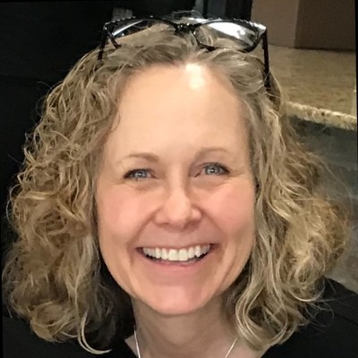
Therese Maggioncalda

Slide 9
Therese Maggioncalda Rotarian Peace Advocate
Rotary
International Service Organization
Over 46,000 Clubs worldwide
Over 1.4 million members worldwide
Rotary’s Seven Areas of Focus

Slide 10
Presentation Disclosure
I am a member of the Taking Action for Peace Initiative, a three Rotary District committee. I was the Co-chair of the Beyond Their Stories Human Trafficking conference held on 9-15-23 at Henry Ford College
I am not an expert on Human Trafficking
The data in this presentation has been resourced from the US Justice Department and Polarisproject.org
The victim resources from this presentation have been recommended and vetted by Human Trafficking Practitioners from the Beyond Their Stories Conference Committee

Slide 11
What is Human Trafficking?
https://www.youtube.com/watch?v=Qpr0GtTGJLg
(Stop this Traffic)
Human Trafficking has been reported in every Zip Code in Michigan
*Polarisproject.org (2020 data)

Slide 12
Human Trafficking is the The 2nd Largest Criminal Enterprise in the World! Number one is Drug Trafficking *Us Justice Department
Labor Trafficking
Farming, Forestry, Construction, Trucking
Domestic Servitude
Nannies, House keepers, Home Health Aids
Debt Bondage
Repayment of debt that never ends
Sex Trafficking
*this is not a complete list

Slide 13
What makes it Human Trafficking?
Fraud
False promises about Wages, Love, Marriage, Legal status
Coercion
Threats of Physical or Psychological harm and Document confiscation
Force
Physical harm, Sexual assault, Confinement, Monitoring, Isolation
Lack of Consent
This is NOT a choice the person makes
*this is not a complete list

Slide 14
Sex Trafficking in Michigan
Alice Jay, Survivor Advocate Theresa Flores, Survivor Advocate
“Sister Survivors” S.O.A.P Project
“Save our Adolescents from Prostitution”

Slide 15
Migrant and Forced Labor Trafficking
Detroit News Headline in June 2023……Two Migrant workers were transported from North Carolina against their will to work at a Michigan Blueberry Farm
Detroit Free Press headline from June 2016…..Five young illegal immigrants including 2 teenagers were killed when a fire broke out in a locked basement. This basement is where the migrants lived in a home owned by the restaurant owner

Slide 16
Sex Trafficking
Detroit News headline and WWJ NewsRadio December 2023…..Massage Spas in Macomb, Oakland and Wayne County, allegedly encouraged female employees to solicit sexual acts from customers. The women had no means of transportation and had no place to live often sleeping in the businesses. The workers didn’t earn an hourly rate and only got paid from their services and tips.

Slide 17
Awareness
https://www.youtube.com/watch?v=44EvOqCMrIE
(Michigan State Police “Look Again”)
National Human Trafficking Resource Line
https://humantraffickinghotline.org
888-387-7888
US Justice Department
https://www.justice.gov/humantrafficking/what-is-human-trafficking

Slide 18
What can you Do to Help?
Understand that Human Trafficking is “Not Prostitution” Because it is not Willful which is the element that makes Prostitution a Crime
Those that are Trafficked “Did not Choose this life”
Remember, Human Trafficking is happening in every Zip Code in Michigan….your neighbor may be a victim
If someone tells you that they may be or are vulnerable to being Trafficked give them the Human Trafficking Hotline Phone# 888-373-7888

Slide 19
National Human Trafficking Hotline
National Human Trafficking Resource Center
Phone 888-373-7888
text BeSafe 233733
Live Chat www.humantraffickinghotline.org

Slide 21
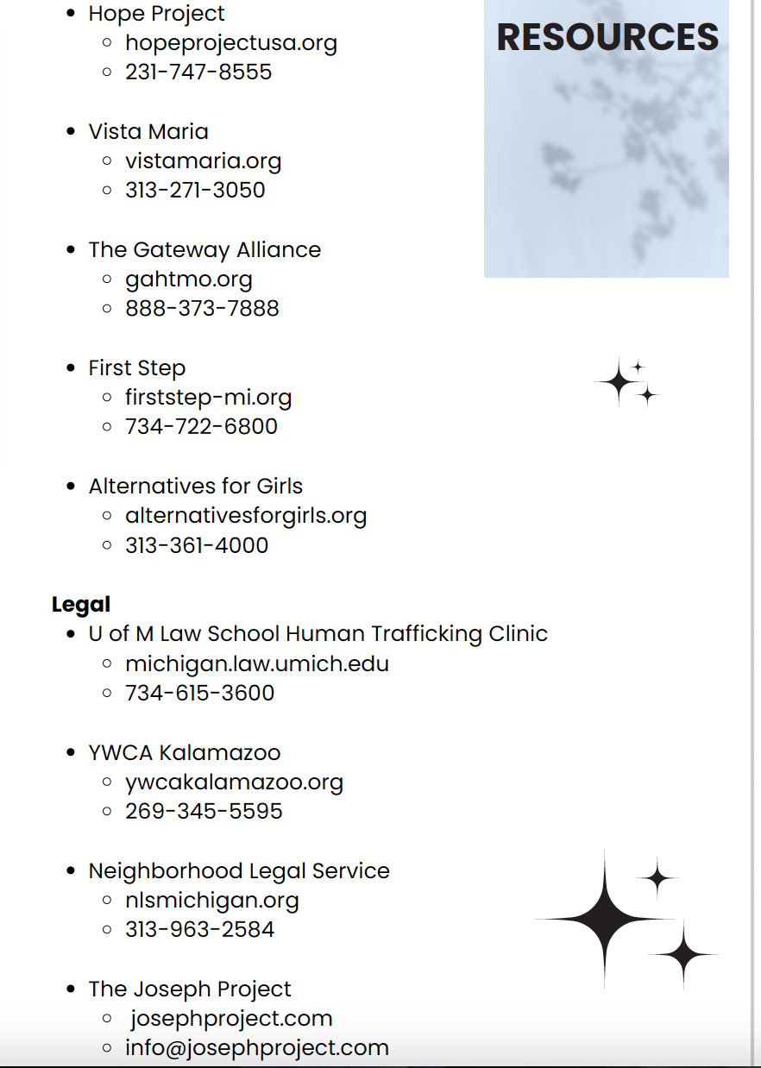
Resource Brochure

Slide 22
50/50 DRAWING And the winner is …..?
This Photo by Unknown Author is licensed under CC BY

